Slide 1
PHYS 1030 Tutorial 1
Yutong Zhao
Department of Physics and Astronomy
University of Manitoba

Slide 2
What is physics?
From Ancient Creek, ‘knowledge of nature‘.
Physics is one of the most fundamental scientific disciplines,
and its main goal is to understand how the universe behaves.
Internet
Big data
Computer
Basis for most modern technology
Challenging
Interesting

Slide 3
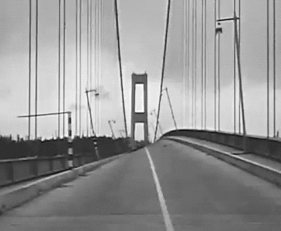
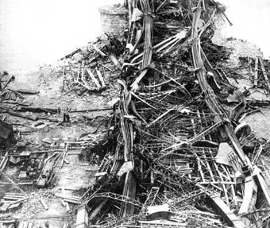
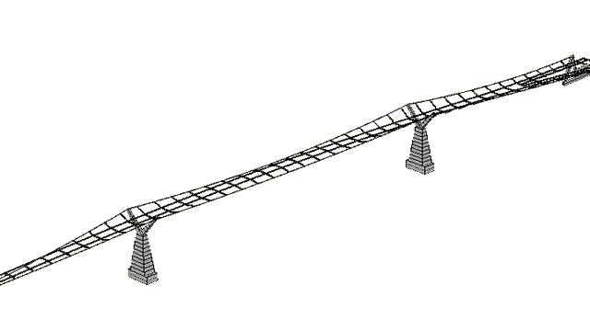
When engineers has a bad background in physics:
Library and Archives Canada / C-057836
Quebec Bridge Disaster
It kills !

Slide 4
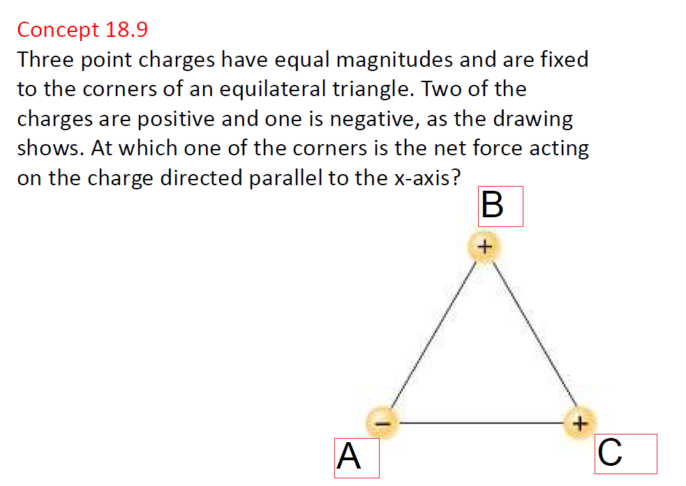

$$\hat{x}$$

Slide 7
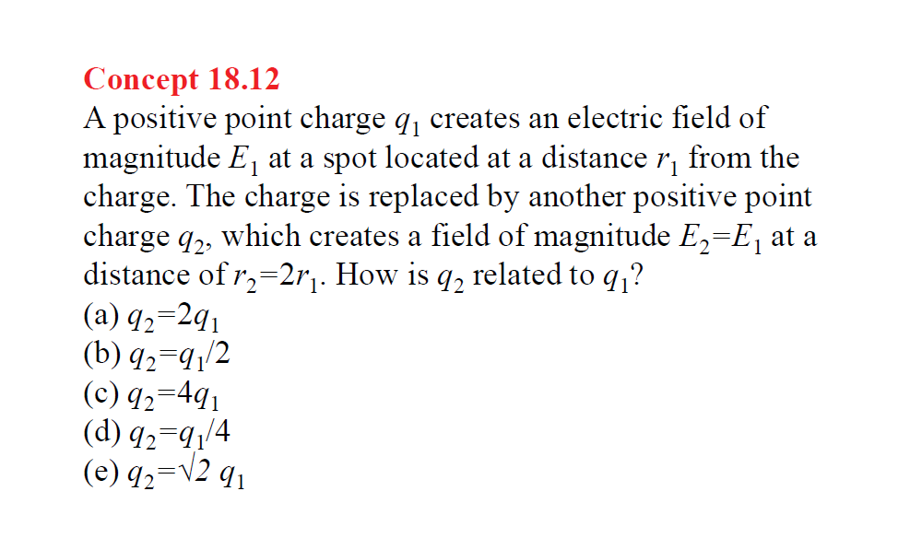
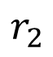
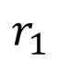
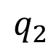
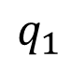
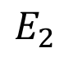
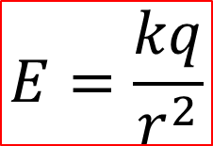
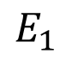
$$E=\frac{kq}{r^{2}}$$
$$r_{1}$$
$$E_{1}$$
$$q_{1}$$
$$r_{2}$$
$$E_{2}$$
$$q_{2}$$

Slide 8
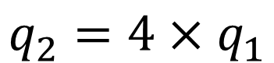
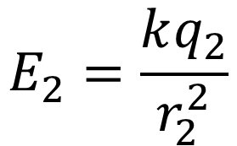
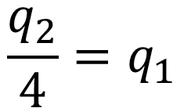
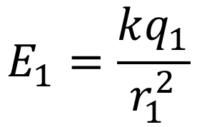
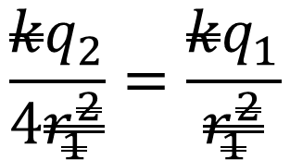
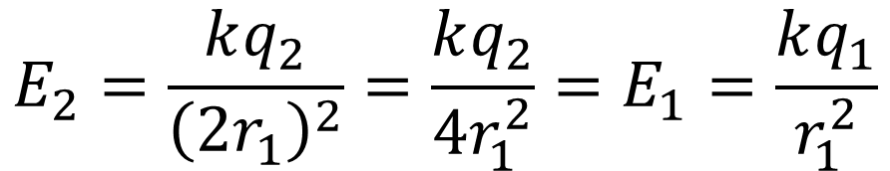
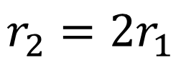
$$E_{1}=\frac{kq_{1}}{r_{1}^{2}}$$
$$r_{2}=2r_{1}$$
$$E_{2}=\frac{kq_{2}}{r_{2}^{2}}$$
$$E_{2}=\frac{kq_{2}}{{\left(2r_{1}\right)}^{2}}=\frac{kq_{2}}{{4r}_{1}^{2}}=E_{1}=\frac{kq_{1}}{r_{1}^{2}}$$
$$\frac{kq_{2}}{4r_{1}^{2}}=\frac{kq_{1}}{r_{1}^{2}}$$
$$\frac{q_{2}}{4}=q_{1}$$
$$q_{2}=4×q_{1}$$

Slide 10
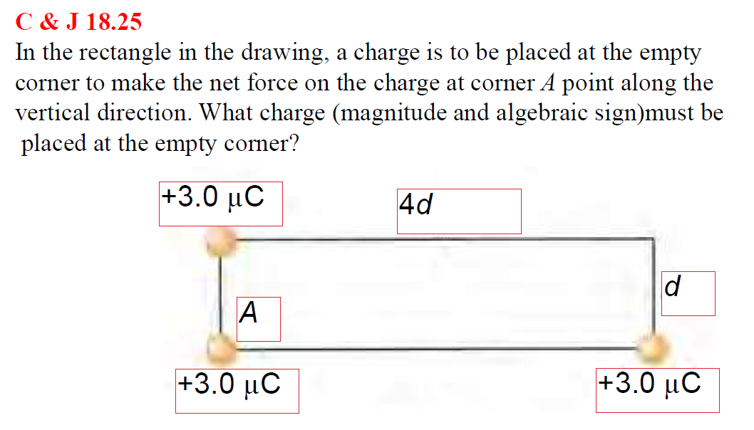

$$?$$

Slide 11
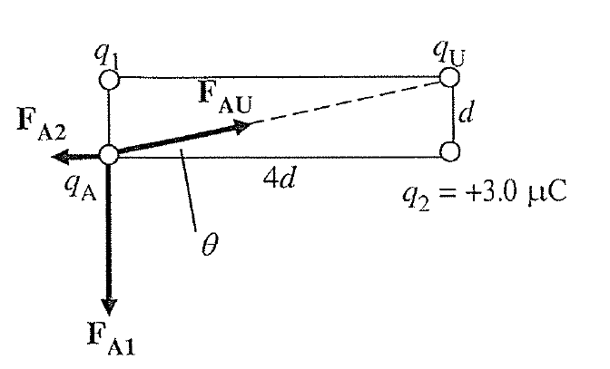

Slide 12
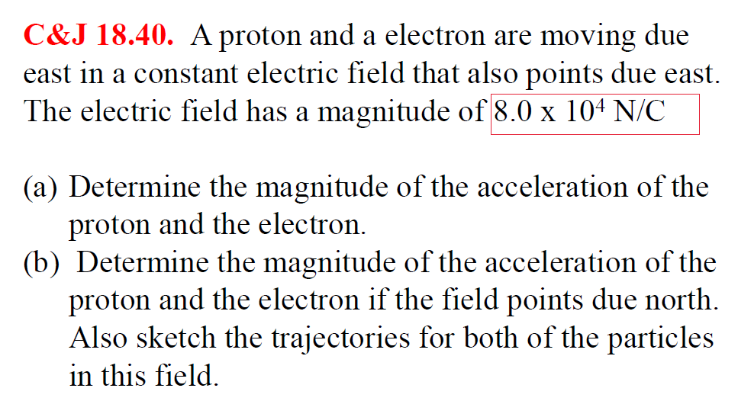

Slide 13


Slide 14
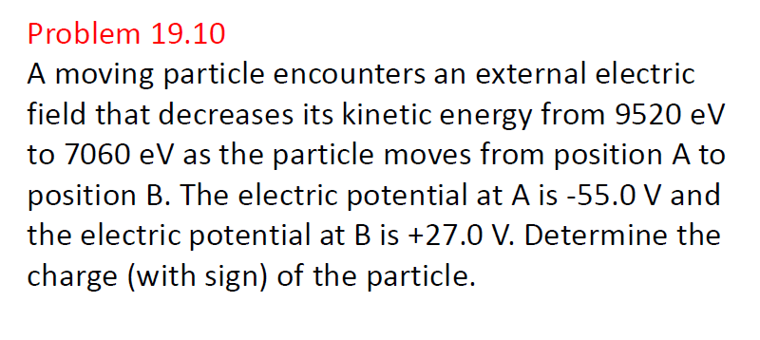

Slide 15
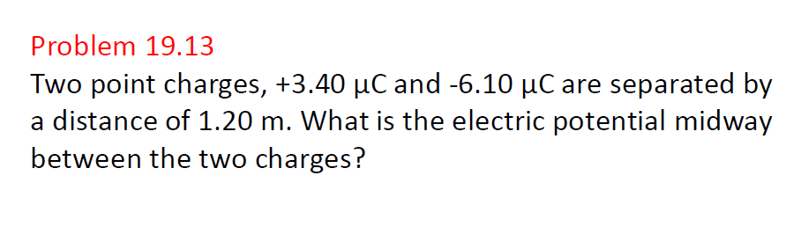

Slide 16
